Slide 1
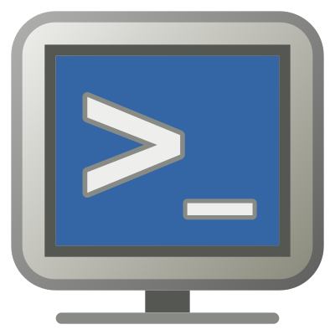
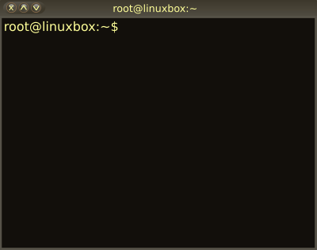

02 – Unix and Shell Commands
COMP 190 – Dickinson College
Fall 2021
Images from: openclipart.org
Notes:
In this class and the activities, you will be learning to interact and work with Linux through the command line.

Slide 2
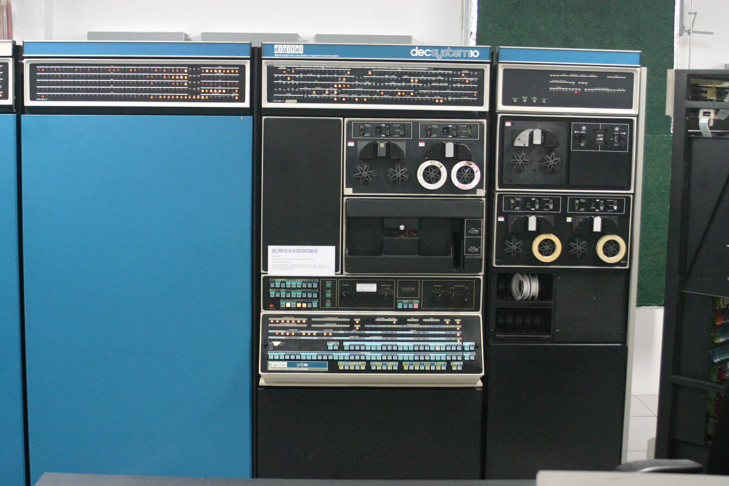
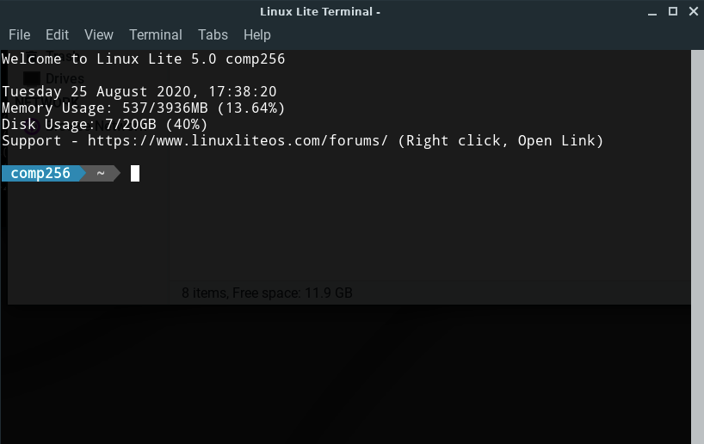
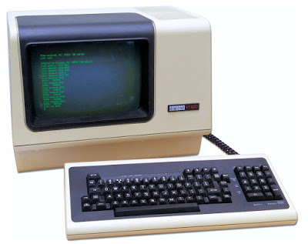
The Terminal/Shell/Command Line Interface
Today a Terminal is a program that runs a Shell (another program), which provides a text-based command line interface (CLI) to the operating system.
Image by Gah4 - CC BY-SA 4.0 https://commons.wikimedia.org/w/index.php?curid=38604047.
Image from: https://www.retromobe.com/
2018/08/digital-dec-vt100.html
Notes:
Today these are often seen as the same thing.
Historically a Terminal was a physical device
That device communicated with the big mainframe computer in the other building or room.
That physical device ran a program or was hardwired to have a shell.
The shell provided a command line interface.
Users typed commands, the shell transmitted them to the computer and displayed the computer’s responses.
Today that is all in one. The terminal now is a program that runs a shell which provides the command line interface that talks with the OS.

Slide 3
Shell Flavors
Because the shell is a program run in the terminal a variety of shell programs (i.e. flavors) have been developed.
Each suited to the particular preferences of its designer.
sh Bourne shell
bash Bourne-again shell
csh / tcsh C shell / Tenex C shell
ksh Korn shell
zsh Z shell
If you are interested in the history/details:
https://www.edureka.co/blog/types-of-shells-in-linux/
Notes:
Boune and Korn named for the person who wrote them originally.
mid-1970s by Stephen R. Bourne while he was at AT&T Bell Labs in New Jersey
David Korn – 1983
Bash is a backward compatible extension of sh
Tcsh is an extension of csh made by the company.

Slide 4
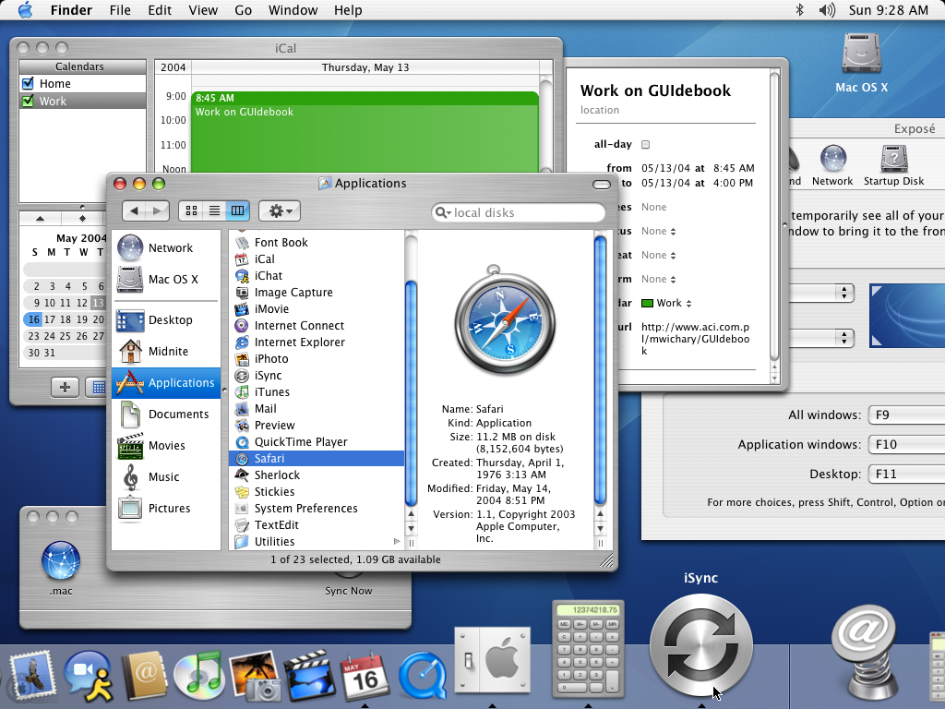
GUI / CLI Equivalence
Interactions with the operating system that can be done with point-and-click through a Graphical User Interface (GUI) can also be done via a Command Line Interface (CLI) and vice versa.
Image from: https://guidebookgallery.org/
screenshots/macosx103
Notes:
Two different ways for accomplishing the same tasks.
Can click and drag files to move – can issue a mv command on the command line that move files.
Can search for files or within files using the search bar – can issue commands like find or grep that search the system.
Things are easier to learn and figure out using a GUI
Things are harder to figure out and remember on a CLI but many are more convenient and efficient once you do.
In particular the more technical things that programmers and developers tend to do.
Thus the popularity of CLIs and importance of leaning to use one.

Slide 5
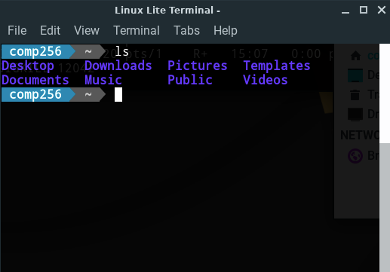
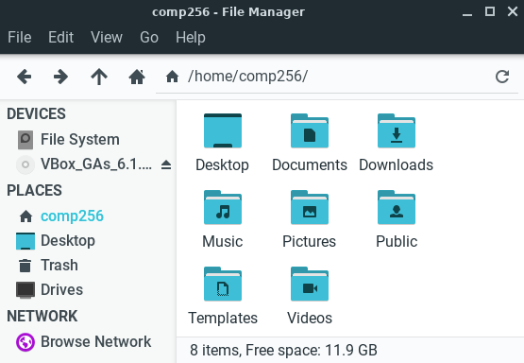
GUI / CLI Equivalence
Notes:
Just as an example, the same information appears in the GUI on the left as in the CLI on the right.
Comp256 directory containing the files Desktop, Documents, etc…
To copy files in the GUI you may need to open mulitple windows and drag and drop.
Not hard to figure out, but cumbersome
In the CLI the same copy would be a one line text command.

Slide 6


Unix File System Structure
root
Files and directories (i.e. folders) are organized into a tree structure.
The location of a file or directory is specified by a path.
Absolute path: complete path starting from the root of the file system.
Relative path: partial path starting from the working directory.
/
bin
etc
home
hoppergm
Documents
Project1
FileA
FileB
Images
FileC
ritchied

Slide 7
Absolute File Paths
Absolute path: complete path starting from the root of the file system.
/bin
/home/hoppergm
/home/hoppergm/Images/FileC
An absolute path always begins with /
root
/
bin
etc
home
hoppergm
Documents
Project1
FileA
FileB
Images
FileC
ritchied

Slide 8
Absolute File Paths
Absolute path: complete path starting from the root of the file system.
/bin
/home/hoppergm
/home/hoppergm/Images/FileC
An absolute path always begins with /
root
/
bin
etc
home
hoppergm
Documents
Project1
FileA
FileB
Images
FileC
ritchied

Slide 9
Absolute File Paths
Absolute path: complete path starting from the root of the file system.
/bin
/home/hoppergm
/home/hoppergm/Images/FileC
An absolute path always begins with /
root
/
bin
etc
home
hoppergm
Documents
Project1
FileA
FileB
Images
FileC
ritchied

Slide 10
Relative File Paths
root
Relative path: partial path starting from the working directory.
We will assume the working directory is /home/hoppergm
Documents
Documents/Project1/FileB
../ritchied
../../bin
/
bin
etc
home
hoppergm
Documents
Project1
FileA
FileB
Images
FileC
ritchied

Slide 11
Relative File Paths
root
Relative path: partial path starting from the working directory.
We will assume the working directory is /home/hoppergm
Documents
Documents/Project1/FileB
../ritchied
../../bin
/
bin
etc
home
hoppergm
Documents
Project1
FileA
FileB
Images
FileC
ritchied

Slide 12
Relative File Paths
root
Relative path: partial path starting from the working directory.
We will assume the working directory is /home/hoppergm
Documents
Documents/Project1/FileB
../ritchied
../../bin
/
bin
etc
home
hoppergm
Documents
Project1
FileA
FileB
Images
FileC
ritchied

Slide 13
Relative File Paths
root
Relative path: partial path starting from the working directory.
We will assume the working directory is /home/hoppergm
Documents
Documents/Project1/FileB
../ritchied
../../bin
/
bin
etc
home
hoppergm
Documents
Project1
FileA
FileB
Images
FileC
ritchied

Slide 14
What’s Next
Ensure LinuxLite in VM is working.
Complete Q01
Complete A02
Following an on-line tutorial
Using your LinuxLite
Answering activity questions
Submit to Moodle A02

Slide 15

Acknowledgments:
Slide Template From:
https://creativecommons.org/licenses/by/4.0/
Slide Content Licensed as:
https://creativecommons.org/licenses/by-nc/4.0/

